Slide 1


Climate Change – is hydrogen the solution?
Lesson Three

Slide 2
Learning Objectives
Key words:
To consider the pros and cons of hydrogen as a clean energy source.
To deliver an independent extended piece of writing or media to lobby government.
To consider solutions to climate change.
Hydrogen
Climate change
Technology
Solutions
Efficient
Emissions
Notes:
Teacher notes:
The ability to communicate scientific information clearly, accurately and succinctly is an essential skill. This lesson is about applying knowledge of Hydrogen fuel cells to persuade stakeholders to invest in Hydrogen as a clean energy source.

Slide 3

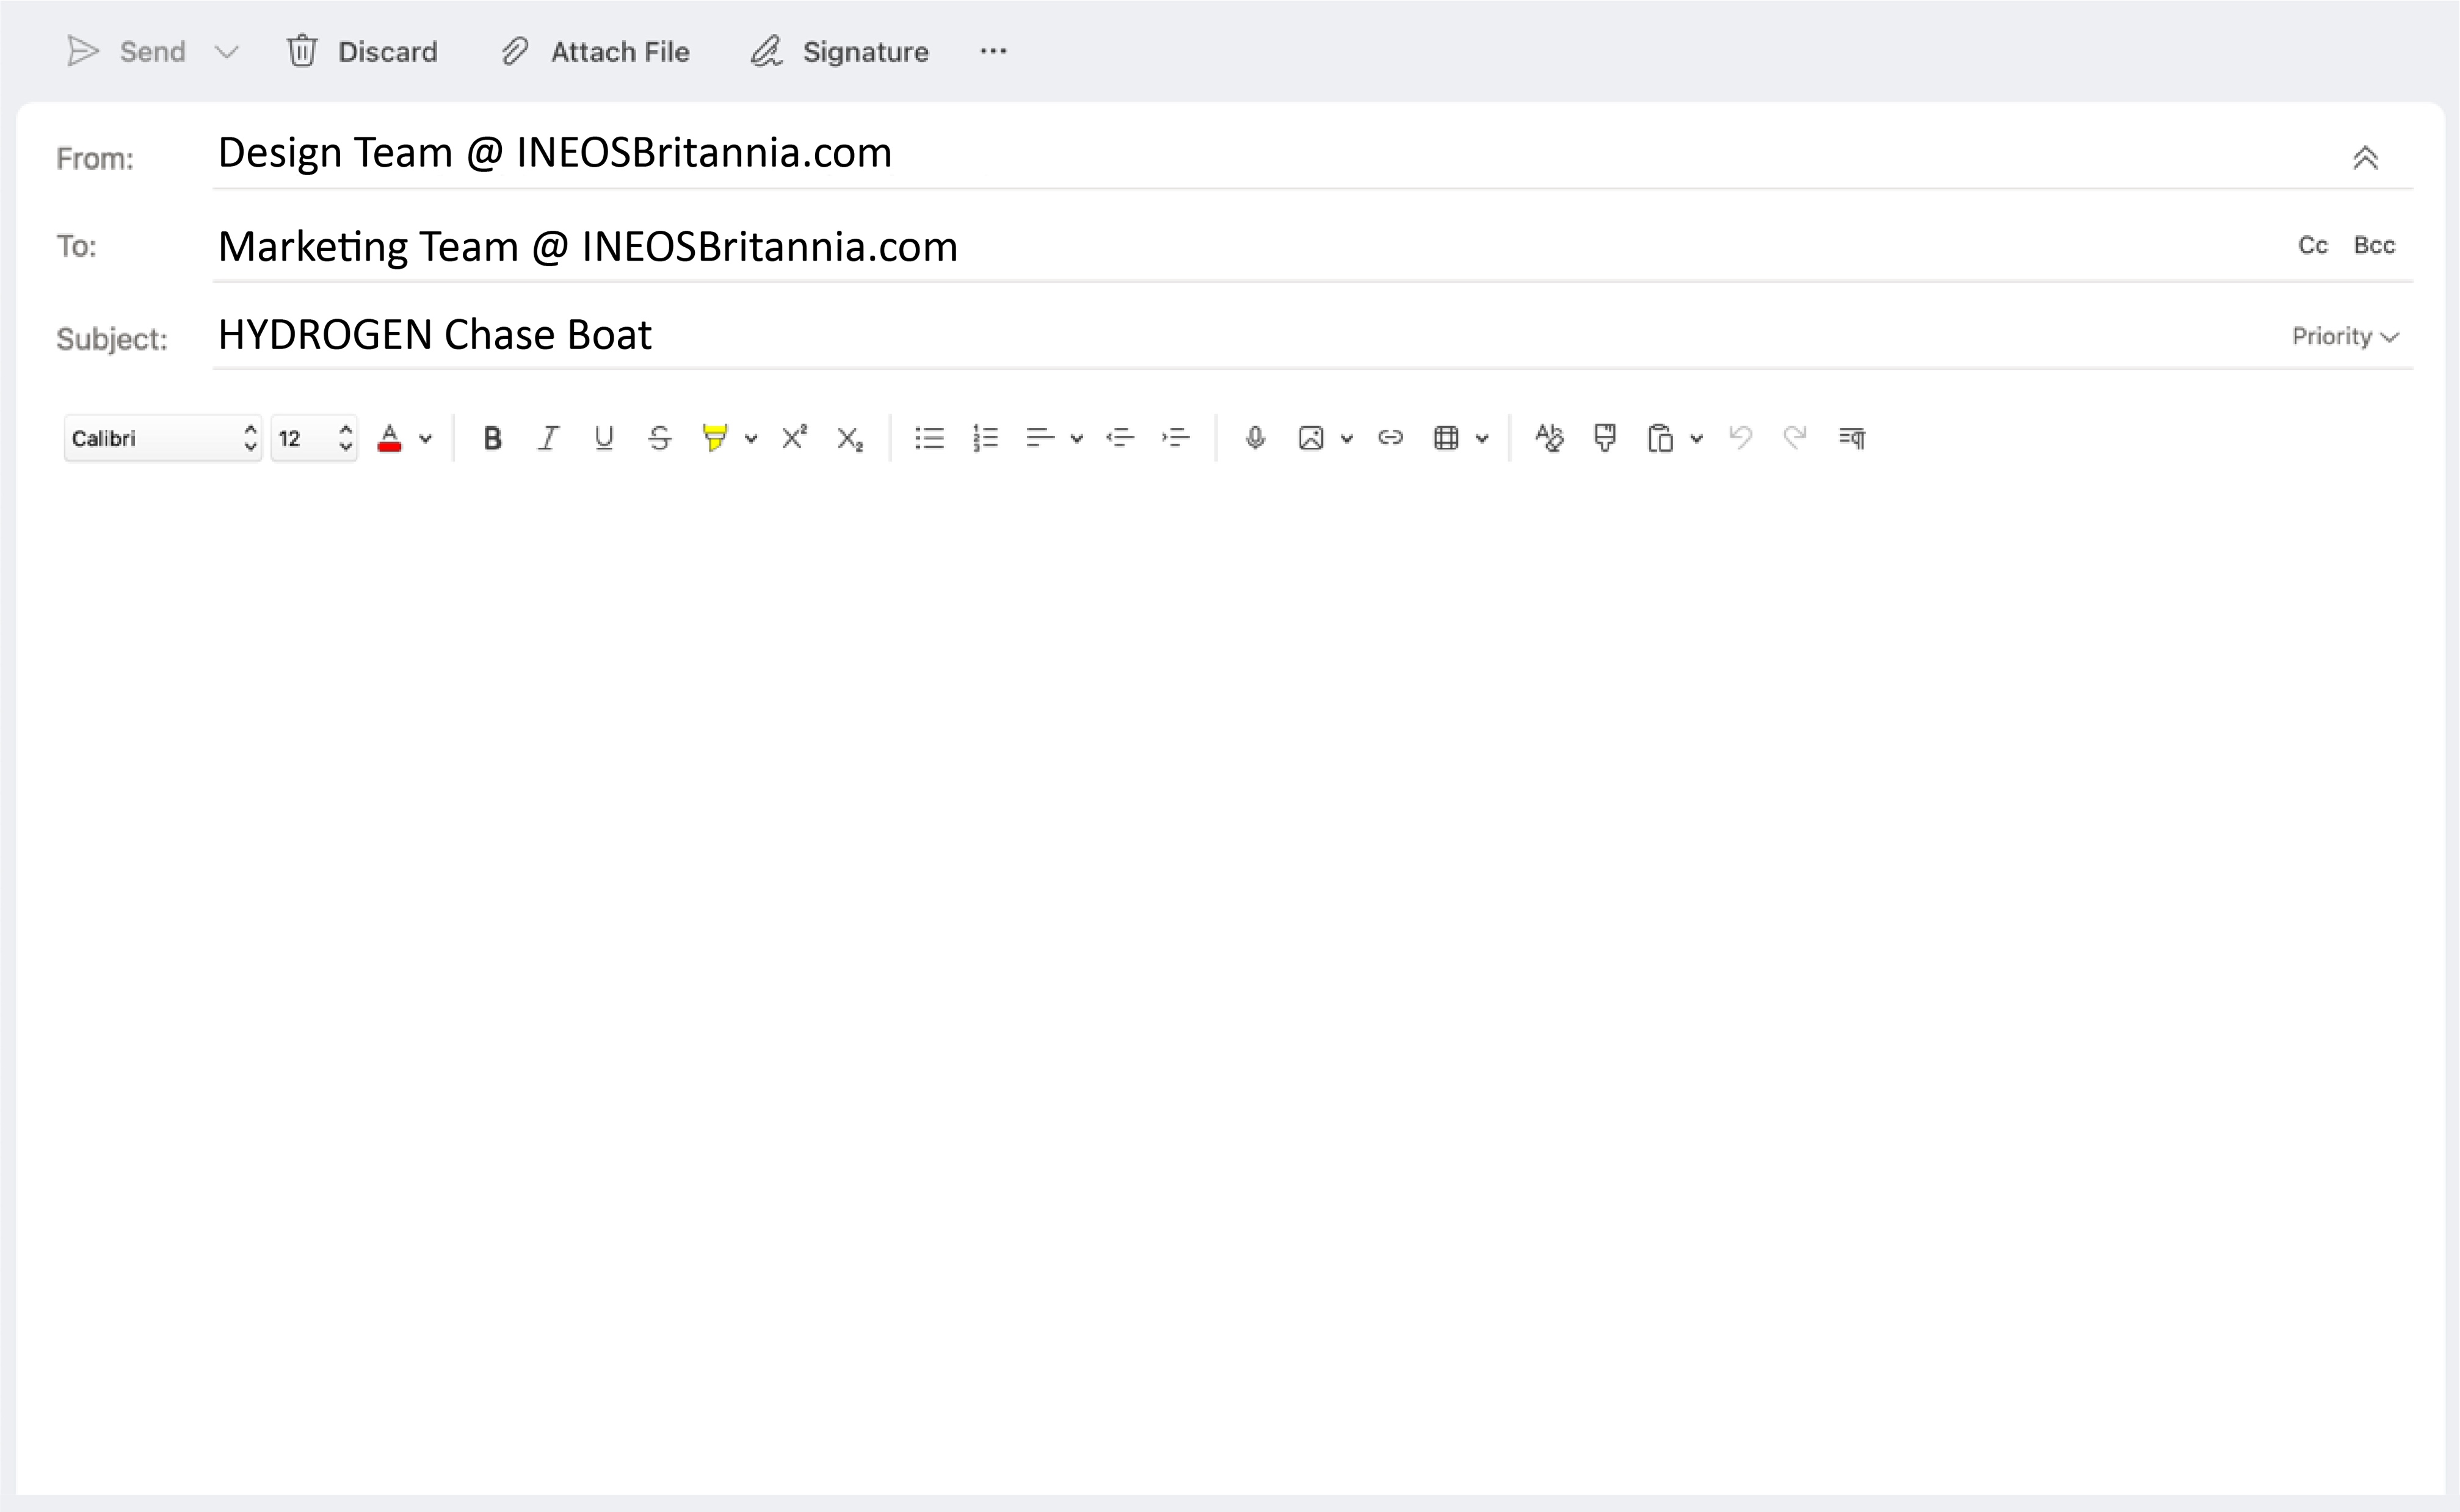


INEOS Britannia UK Hydrogen Chase Boat
At INEOS Britannia, we have been busy designing and building a hydrogen-powered foiling chase boat to use in the 37th America’s Cup. We believe our boat forms part of the solution to managing the global climate crisis. It uses hydrogen fuel cells to power it, ensuring zero harmful emissions when in use.
We would like to promote our innovative design across the marine industry, and we firmly believe that hydrogen energy is the future of powered boats, eradicating the need for fossil fuel power and reducing emissions to meet the Net Zero targets of 2050.
However, we need your help. Hydrogen has had a poor reputation in the past, and many people need to be convinced that this is a technology worth investing in. Therefore, your role as Marketing Executive is to promote the message that hydrogen is not only safe, but it is an essential component in the fight against climate change for our planet.
Notes:
Teacher notes:
Read the email to your pupils and begin to suggest which knowledge they will need to draw on from the past 2 lessons to be able to respond to this challenge.

Slide 4

Independent Research Project
In order to promote the INEOS Britannia chase boat, it is important to know the advantages and disadvantages of using hydrogen as an energy source.

Slide 5
Hydrogen as an energy source: Advantages
Renewable and abundant
Hydrogen is the most abundant element in the universe and, despite the challenges associated with its extraction from water, it is a uniquely abundant and renewable source of energy.
Clean and flexible
Hydrogen fuel cells provide a clean source of energy, with no adverse environmental impact. The only by-products generated are simply heat and water.
No noise or visual pollution
Hydrogen fuel cells are compact and do not require the same area of space as other green energies. Hydrogen fuel cells do not produce any noise and vehicles are much quieter.
Powerful and energy efficient
Hydrogen has the highest energy content of any common fuel by weight.
Highly efficient
Hydrogen fuel cells are more efficient (by around 30%) than most other energy sources, including many green energy solutions.
Long usage times
Hydrogen-powered vehicles can travel much further than recently developed electric vehicles.
Notes:
Teacher notes:
This slide could be added to Google Classroom for pupils to refer to during their independent work.

Slide 6
Hydrogen as an energy source: Disadvantages
Hydrogen extraction
Despite being the most abundant element in the universe, hydrogen does not exist on its own and so needs to be extracted from water via electrolysis or separated from carbon fossil fuels.
Cost of raw materials
Precious metals such as platinum and iridium are typically required as catalysts in fuel cells and some types of water electrolyser, which means that the initial cost of fuel cells can be high.
Hydrogen storage
Storage and transportation of hydrogen is more complex than that required for fossil fuels.
Highly flammable
Hydrogen is a highly flammable fuel source, which brings understandable safety concerns.
Notes:
Teacher notes:
This slide could be added to Google Classroom for pupils to refer to during their independent work.

Slide 7
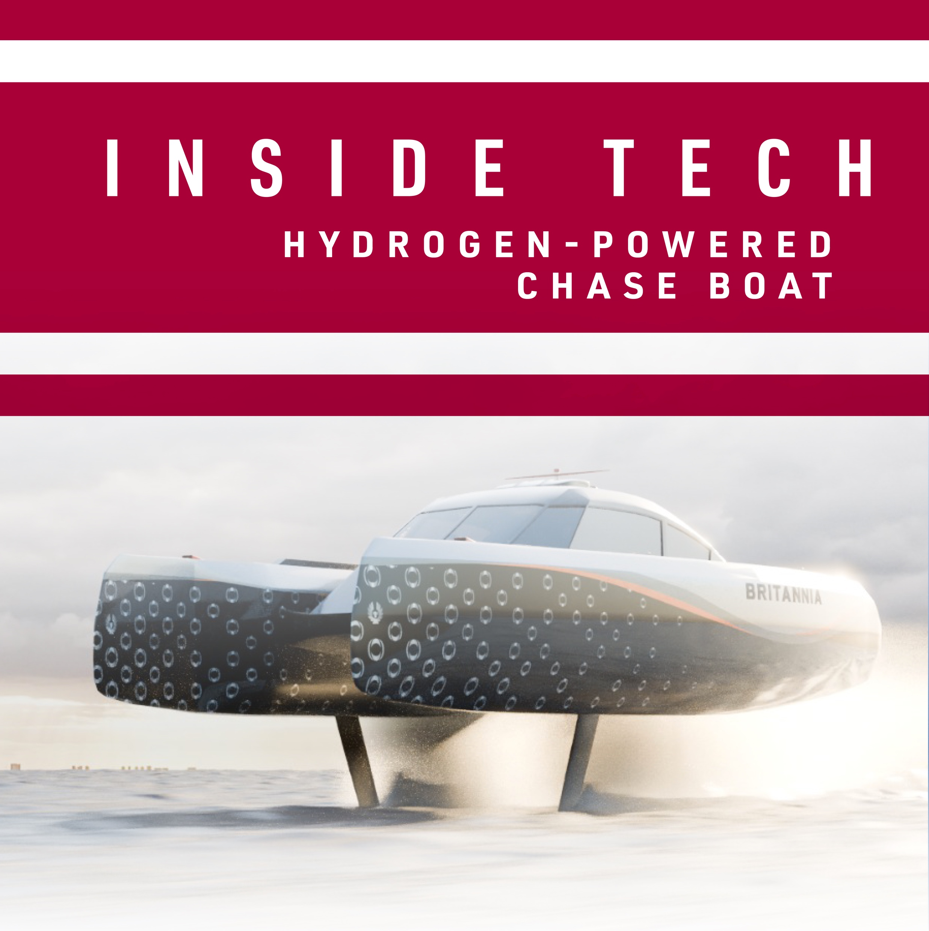
Your Task
Imagine you work for the Communications and Media Department of INEOS Britannia.
You are responsible for producing articles for the ‘Inside Tech’, IB’s online news hub.
Your task is to produce an article about INEOS Britannia’s new hydrogen chase boat, to promote it and explain how it works.

Slide 8
Your Task
You will need to consider:
Technical information about hydrogen fuel cells.
How energy is transferred from the fuel cell, resulting in kinetic energy.
The advantages of the boat and hydrogen as a source of clean energy.
How hydrogen power could be extended to the whole of the marine industry.
What needs to be done to our infrastructure to prepare for more hydrogen-powered vehicles.

Slide 9



Presentation
You may present your work as:
A written article for a newspaper/ magazine/online media source
A talk or article for a news report.
A slideshow to present to a group of marine industry leaders.

Slide 10
How successful were you?
Feeling confident?
I can state the advantages of hydrogen as an energy source.
I can state the disadvantages of hydrogen as an energy source.
I can communicate scientific ideas clearly.
In need of a challenge?
I can refer to my scientific knowledge in my communications.
I am able to suggest technological solutions to climate change.

