Slide 1


Energy transfer from fuel cells
Lesson Two

Slide 2
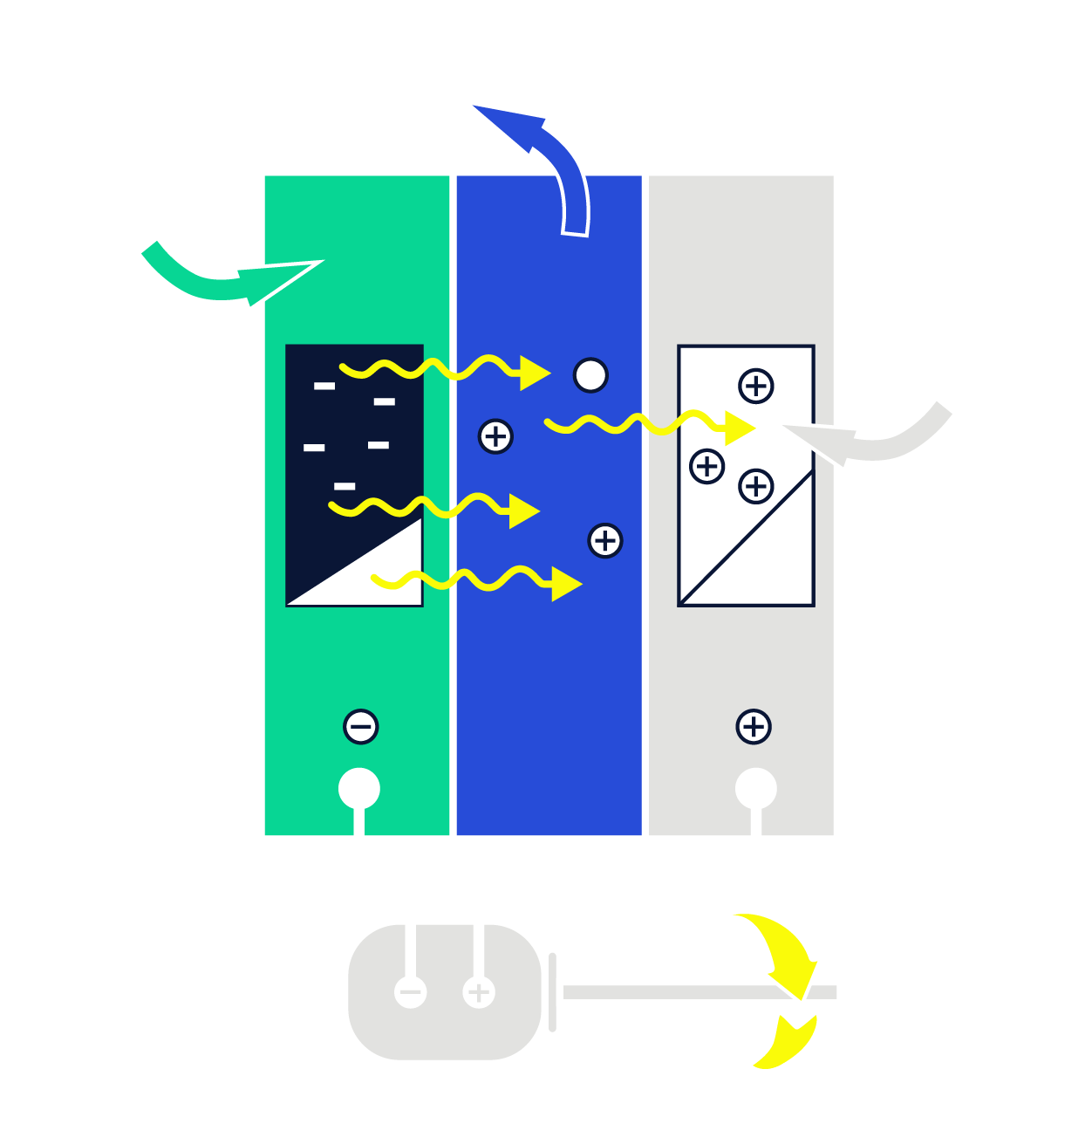
How can we use the energy from a fuel cell?
Hydrogen fuel cell
Hydrogen fuel cells allow Chase Zero to use the chemical energy inside the fuel cell to be converted into kinetic energy for moving the boat along.
But how is this chemical energy transferred?

Slide 3
Learning Objectives
Key words:
To understand there are many different types of energy.
To know that energy can be transferred from one form to another.
To give examples of energy stores.
To know that there are 4 types of energy transfer.
Energy store
Energy transfer
Kinetic
Thermal
Chemical

Slide 4
Energy Stores
There are many different types of energy. Can you list the ones that you know?
Nuclear
Thermal
Kinetic
Chemical
Sound
Gravitational
Electrical
Elastic
Light
Notes:
Teacher notes:
Solutions on next slide.

Slide 5
Energy Stores
Can you match the energy store to the examples?
Nuclear
Talking, TV, radio
Thermal
A wind up toy, rubber band
Chemical
Light bulbs, a Bunsen flame
Elastic
Anything that is moving
Sound
Hot water, a hot radiator
Electrical
A book on a shelf, a bungee jumper
Light
Food, batteries, burning things
Kinetic
Nuclear bombs, power stations
Gravitational
Anything that uses electricity
Notes:
Teacher notes:
Solutions on next slide.

Slide 6



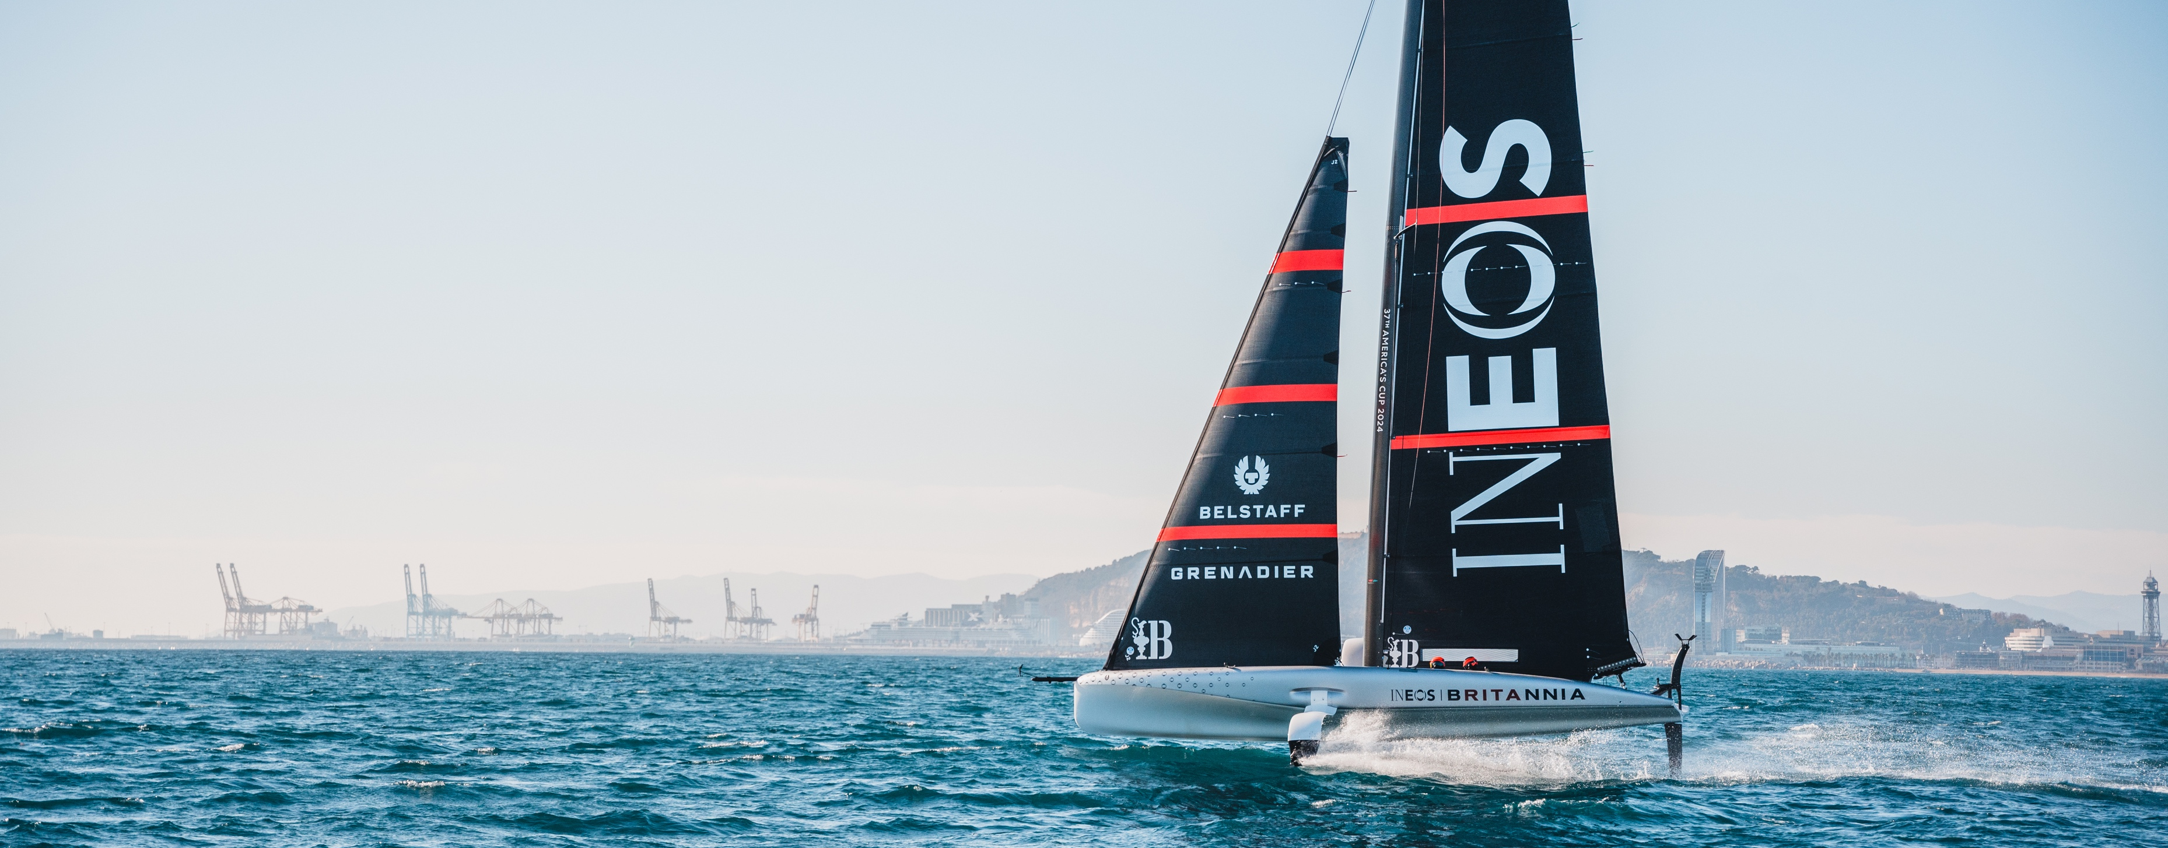


Energy Stores
Moving objects store energy in their kinetic energy store.
Stretched objects store energy in their elastic potential energy store.
A warm or hot surface has more energy in its thermal energy store than when it is cold.
Notes:
Teacher notes:
Solutions on next slide.

Slide 7


Energy Transfer
Energy can be transformed from one store to another
Chemical energy from nutrition is transferred to kinetic energy when moving around the AC75 boat.
Chemical Energy
Kinetic Energy
Notes:
Teacher notes:
Solutions on next slide.

Slide 8
Energy Transfers
Energy can be transferred in four ways between energy stores:
Heat
Radiation
Electrical
Mechanical

Slide 9
Energy Transfers
Heat
Radiation
Electrical
Mechanical
Heat travels from hot to cold places.
Energy is transferred using waves (e.g. light).
Through a flow of charge (current).
When a force is applied to move an object over a distance.
Notes:
Teacher notes:
Solutions on next slide.

Slide 10
Now it’s your turn
Can you think of any other examples of energy transfer?
Your teacher will have given you a set of loop cards.
Read out the name of your store and your classmate will have the accompanying definition which they will read out.
Notes:
Teacher notes:
Solutions on next slide.

Slide 11
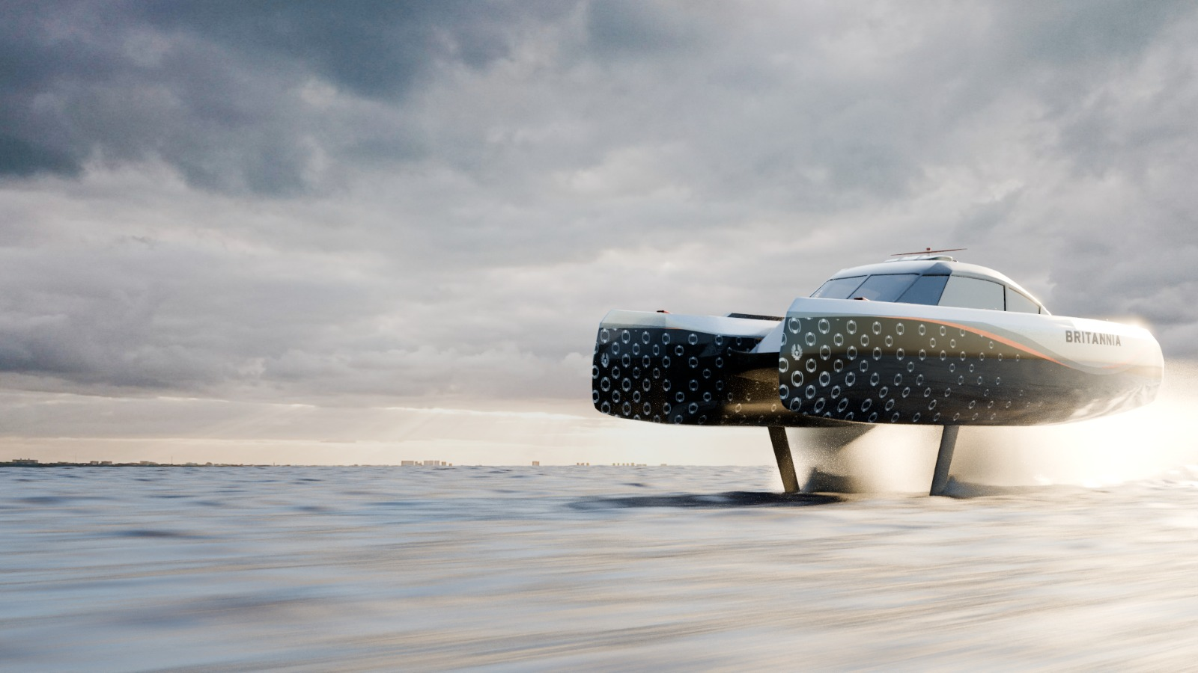
How does energy transfer take place in a hydrogen-powered boat?
Energy Transfers
Notes:
Teacher notes:
Solutions on next slide.

Slide 12





Energy Transfers
In a hydrogen-powered boat, the primary energy transfer involves the conversion of chemical energy stored in molecular hydrogen (H₂) into electrical energy through a fuel cell.
Chemical energy in hydrogen
Electrical energy in the fuel cell
Mechanical energy to propel the boat
Kinetic energy when boat is moving

Slide 13
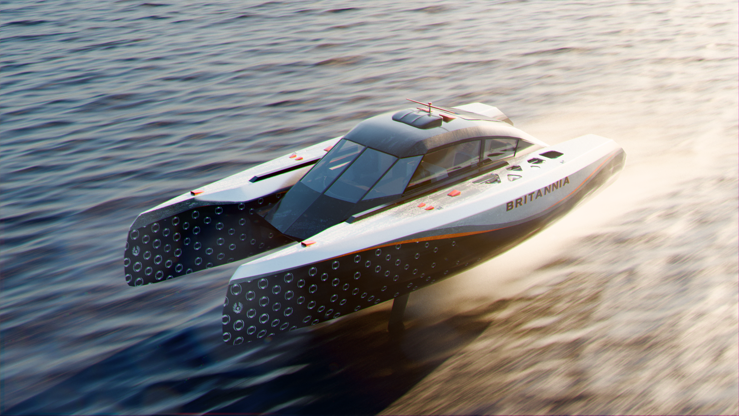
Energy Pathways
An energy pathway outlines the journey of energy from its source to its ultimate use or destination.
The fuel cell of a hydrogen-powered boat transfers energy from the chemical energy store of the fuel cell to the kinetic energy store of the moving boat. The energy is transferred mechanically as the motor applies forces to propel the boat.
mechanically
Chemical energy store
Kinetic energy store

Slide 14
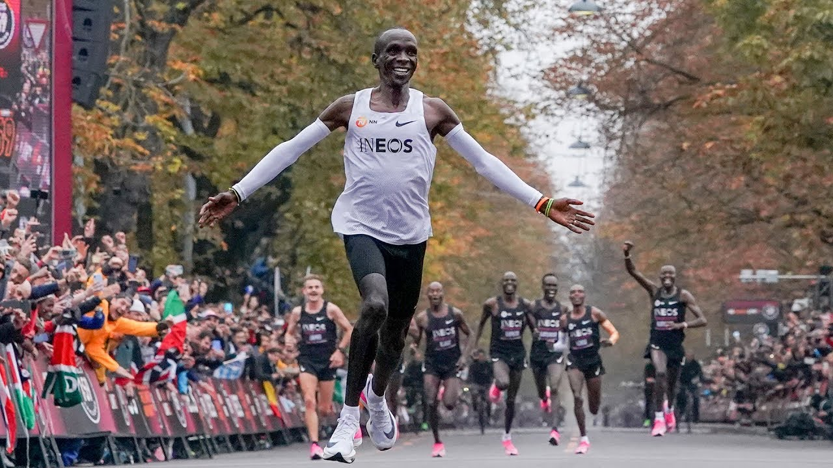
Now it’s your turn
Energy Pathways
Complete the energy pathways for the following scenarios:
Complete the energy pathways for the following scenarios:
Eluid Kipchoge transferring energy from his muscles into movement during the INEOS 1:59 challenge.
mechanically
Chemical energy store
Kinetic energy store
Notes:
Teacher notes:
Solutions on next slide.

Slide 15

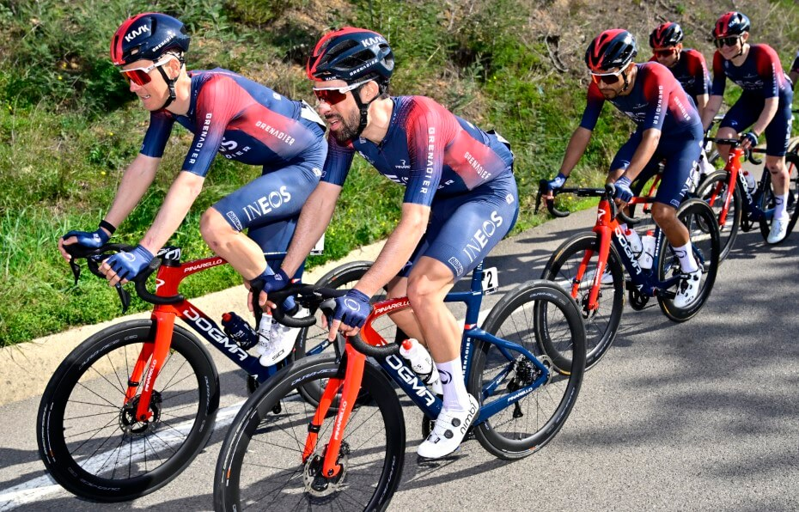
Now it’s your turn
Complete the energy pathways for the following scenarios:
The INEOS Grenadiers freewheeling down a hill.
mechanically
Gravitational potential energy store
Kinetic energy store
Notes:
Teacher notes:
Solutions on next slide.

Slide 16
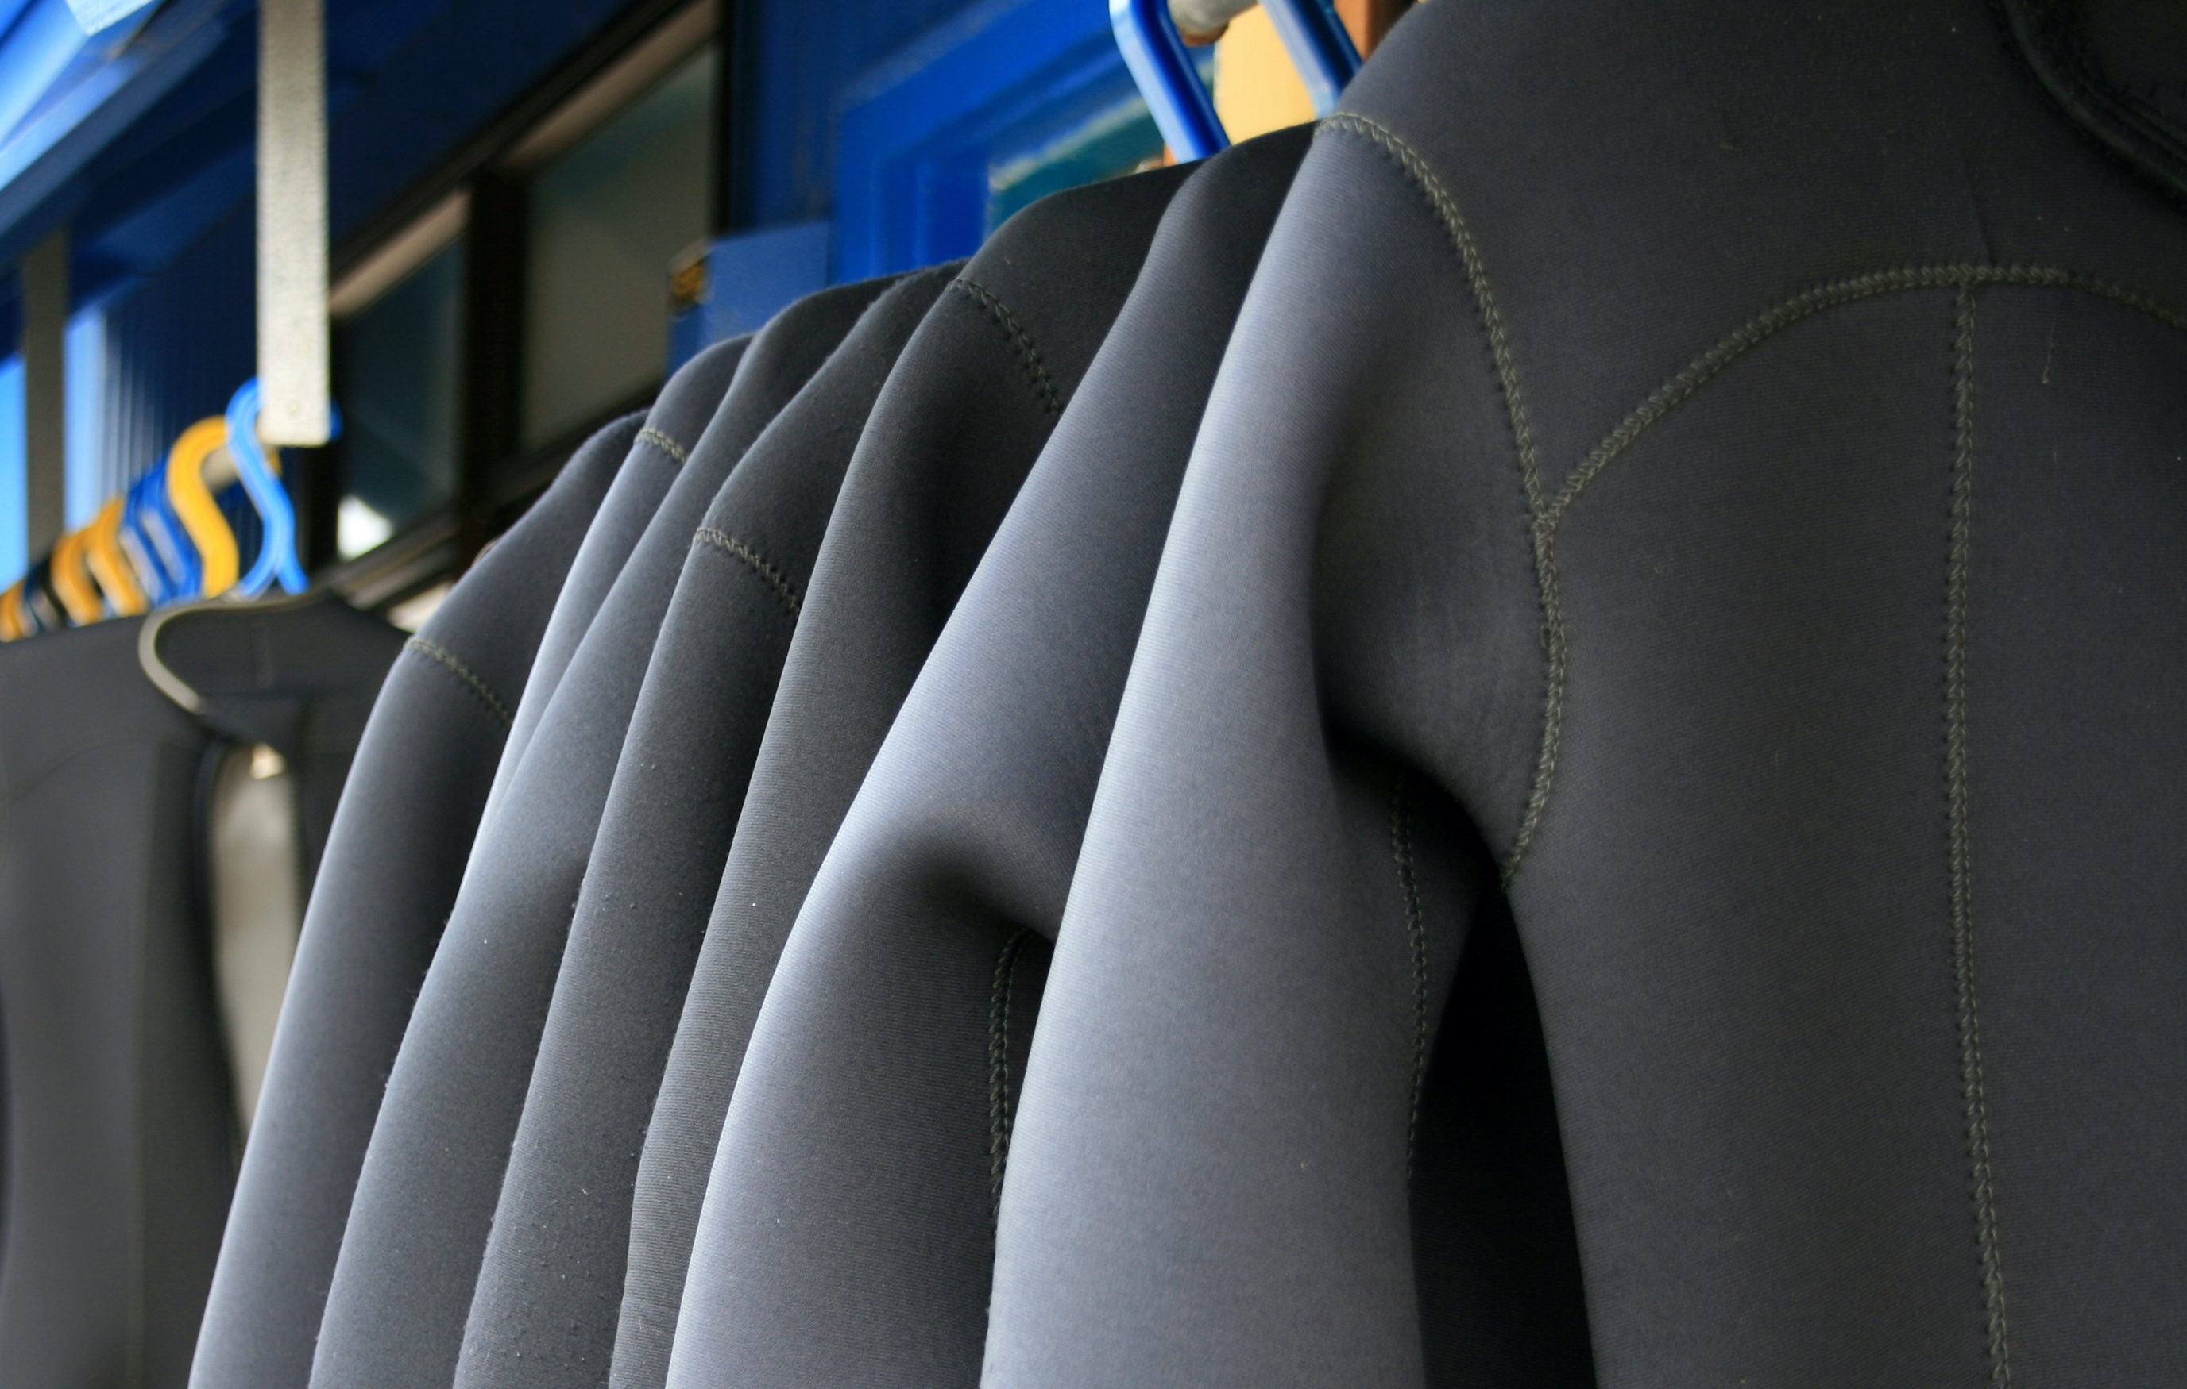
Heating
Thermal energy store
Thermal energy store
Now it’s your turn
Complete the energy pathways for the following scenarios:
INEOS Britannia drying wetsuits in the sunshine.
mechanically
Thermal energy store (sun)
Thermal energy store (wetsuit)
Notes:
Teacher notes:
Solutions on next slide.

Slide 17

Now it’s your turn
Complete the energy pathways for the following scenarios:
Now write a scenario for your partner and state the energy pathway.
Notes:
Teacher notes:
Solutions on next slide.

Slide 18
How successful were you?
Feeling confident?
I can explain what an energy store is.
I know that energy is transferred from one store to another.
I can give examples of energy stores.
In need of a challenge?
I can state 4 methods of energy transfer.
I state how energy is transferred in a hydrogen-powered boat.

