Slide 1

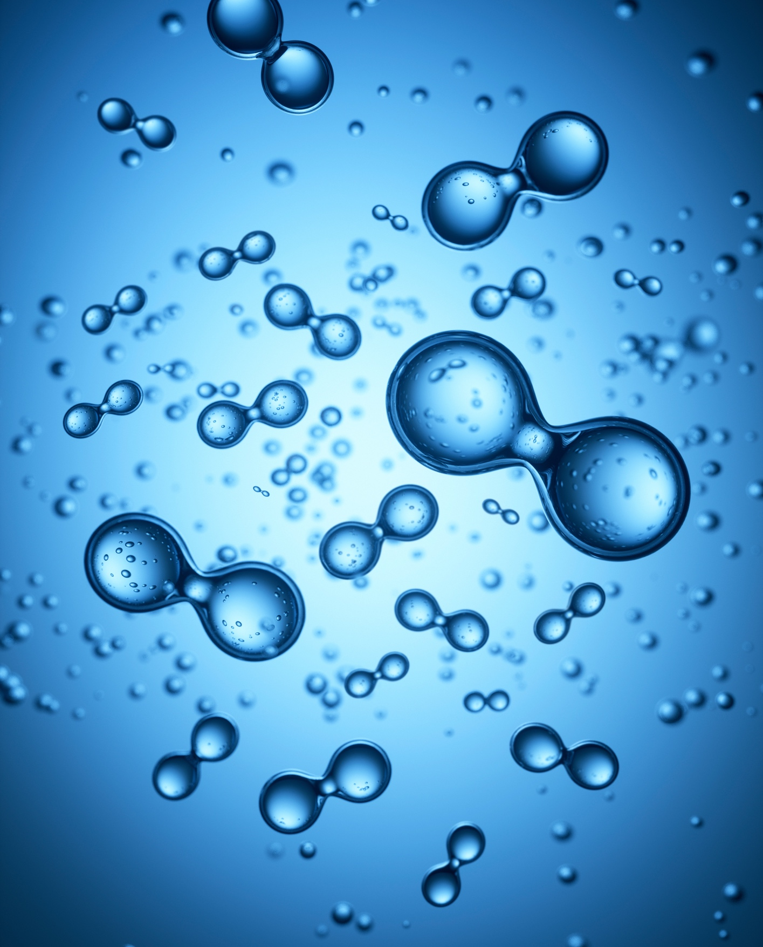
Can you design a hydrogen-powered boat?
Lesson One

Slide 2
Learning Objectives
Key words:
To understand that energy can be renewable or non-renewable.
To know that hydrogen can be used as a clean energy source.
To understand the by-products of using hydrogen as an energy source.
Hydrogen
Energy
Renewable
Clean energy
Fossil fuels
Fuel cell

Slide 3
What do you already know? Q
Match the words to the definitions
Energy derived from organic matter and organisms, such as wood, agricultural waste and compost. It can be burned directly or processed into biofuels (e.g. ethanol and methane).
Biomass energy
Fossil fuels
A resource that will eventually run out.
Fuels formed in the past from the remains of living animals. E.g. oil, natural gas and coal.
Finite resource
Energy generated from recyclable sources that does not emit greenhouse gases.
Crude oil
A liquid fossil fuel formed under intense pressure over millions of years from the organic remains of tiny sea creatures.
Clean energy
Notes:
Teacher notes:
Solutions on next slide.

Slide 4
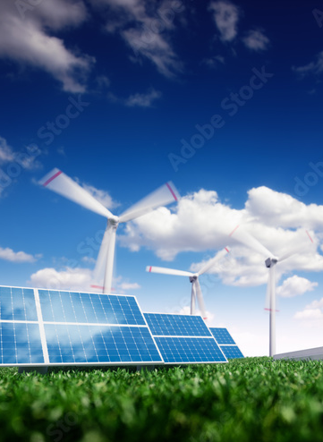
Renewable Energy
In the long term, consuming energy from renewable energy sources is not only the best option but the only option because the way we currently produce and use energy is not sustainable.
Fossil fuels such as oil, coal and gas are the main contributors to climate change, and only with sustainable renewable energy sources can we guarantee energy for all people in the future.

Slide 5



The 37th America’s Cup
The America’s Cup is as much a technology race as it is a sailing regatta. Over the years, the America’s Cup has pushed the boundaries of innovation in STEM (science, technology, engineering and maths).
INEOS Britannia as the Challenger of Record, along with Emirates Team New Zealand, the current Defender of the America’s Cup, introduced an exciting new innovation in the AC37 Protocol (set of rules), with the introduction of hydrogen-powered foiling chase boats.

Slide 6
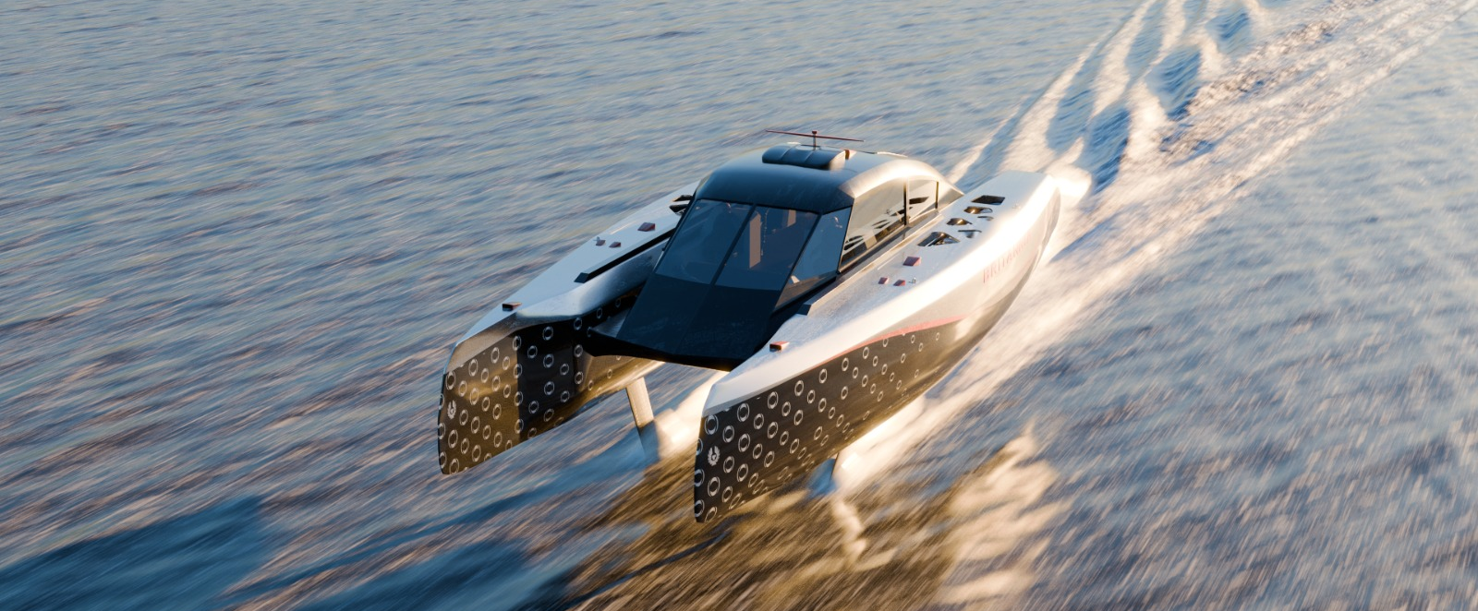

Chase Zero
Chase Zero is a Hydrogen-powered foiling chase boat.
In the past, chase boats have been powered by fossil fuels.
The role of the chase boat is to follow the racing yachts.
There are team members onboard, collecting data and ensuring the safety of the crew onboard the racing yacht.
Racing Yacht
Chase Boat

Slide 7
Checkpoint: Q
Which statement below best describes hydrogen as an element?
Imagine you work for INEOS Britannia and you are responsible for designing a boat that uses clean energy.
Hydrogen is a metal with high electrical conductivity.
Hydrogen is a noble gas commonly used in lighting.
Hydrogen is the lightest and most abundant element in the universe.
Hydrogen is a halogen known for its reactivity with alkali metals.
Notes:
Teacher notes:
Solutions on next slide.

Slide 8
Checkpoint: A
Which statement below best describes hydrogen as an element?
Imagine you work for INEOS Britannia and you are responsible for designing a boat that uses clean energy.
Answer:
The answer is ‘C’, hydrogen is the lightest and most abundant element in the universe. All of our Hydrogen on Earth comes from the sun.
Notes:
Teacher notes:
Solutions on next slide.

Slide 9

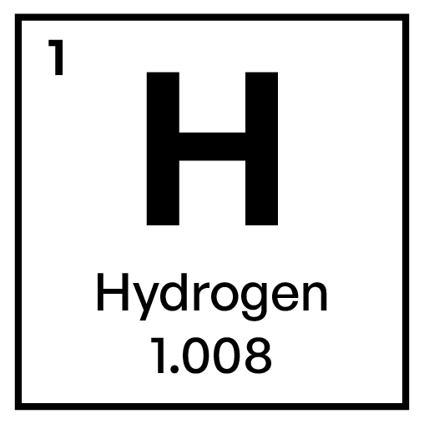

All about Hydrogen
Hydrogen is the simplest element. Each atom of hydrogen has only one proton. Hydrogen is also the most abundant element in the universe. Stars such as the sun consist mostly of hydrogen. The sun is essentially a giant ball of hydrogen and helium gases.
Hydrogen occurs naturally on earth only in compound form with other elements in liquids, gases, or solids.

Slide 10
All about Hydrogen
Hydrogen combined with oxygen is water (H₂O).
Hydrogen combined with carbon forms different compounds - or hydrocarbon - found in natural gas, coal, and petroleum.
Hydrogen is an energy carrier.
Energy carriers allow the transport of energy in a usable form from one place to another.

Slide 11

All about Hydrogen
Hydrogen, like electricity, is an energy carrier that must be produced from another substance.
Hydrogen can be produced—separated—from a variety of sources including water, fossil fuels, or biomass and used as a source of energy or fuel.
Hydrogen is used to provide energy via a fuel cell.

Slide 12
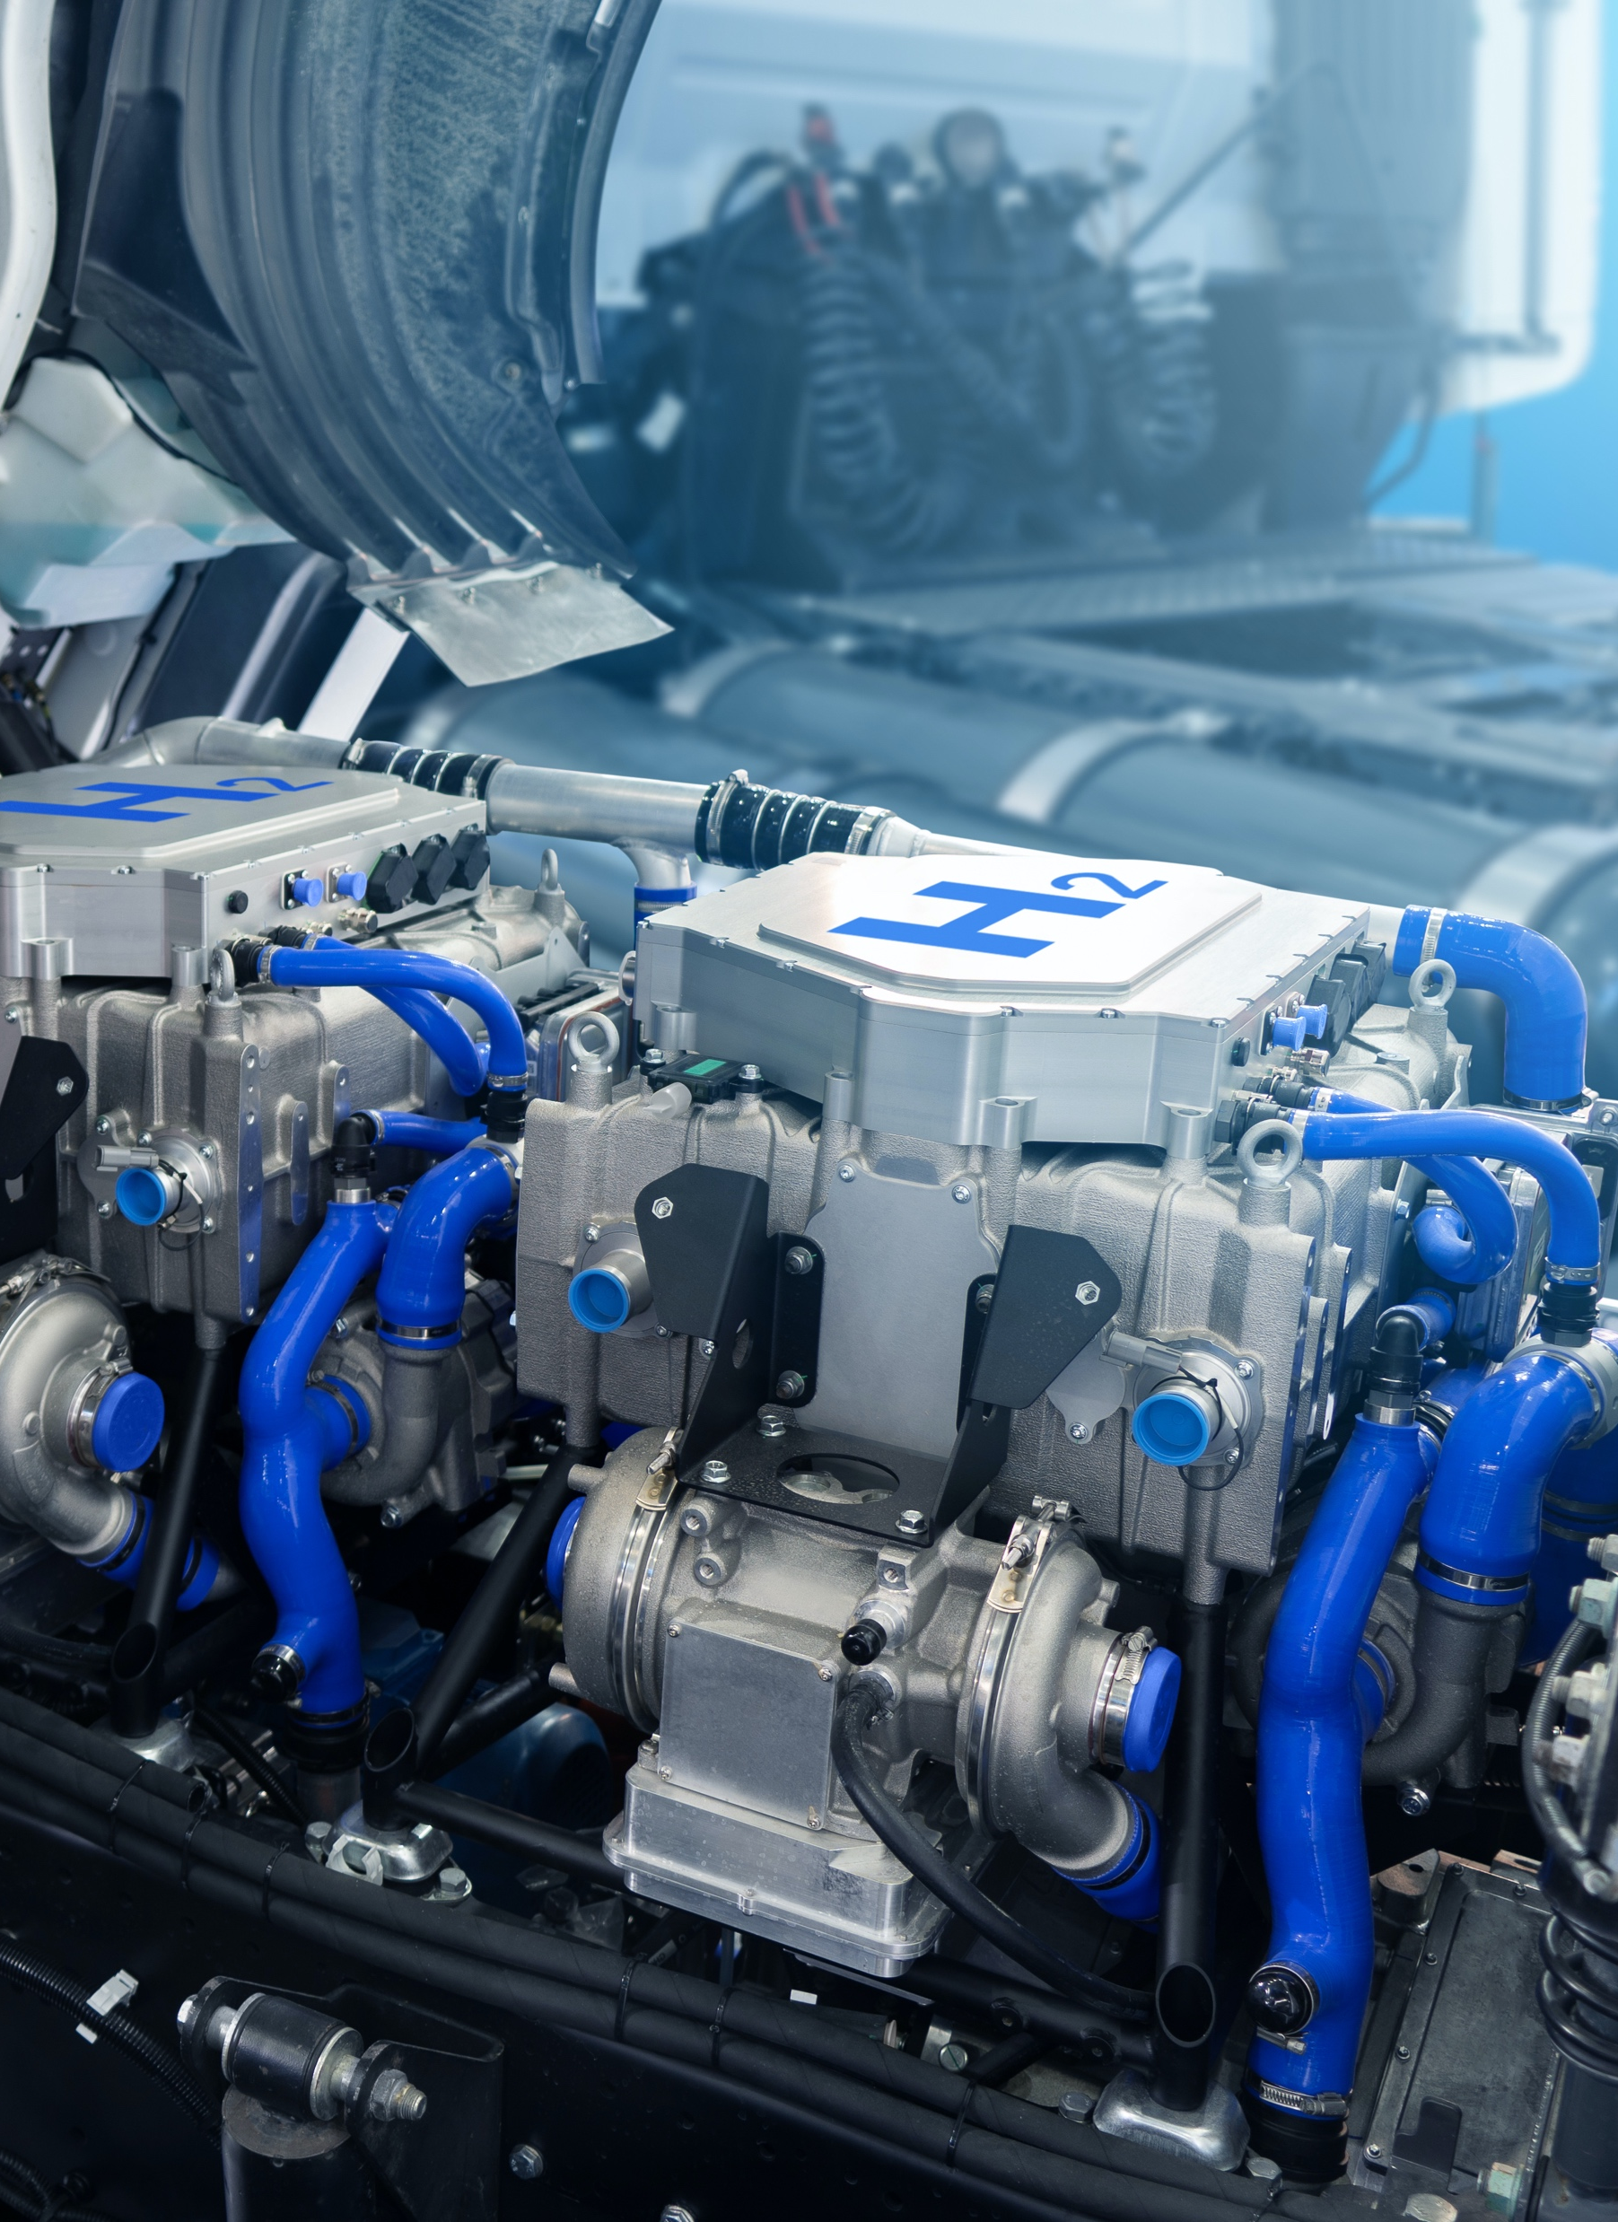
What is a fuel cell?
A fuel cell is a device that makes electricity using the energy released by mixing fuel with air, a reaction which creates water and sometimes also carbon dioxide.
The most common fuel for fuel cells is hydrogen, which when reacted with oxygen from air produces only water. Fuel cells work like a battery being constantly fed with fuel so it never runs out (as long as you have enough fuel).

Slide 13
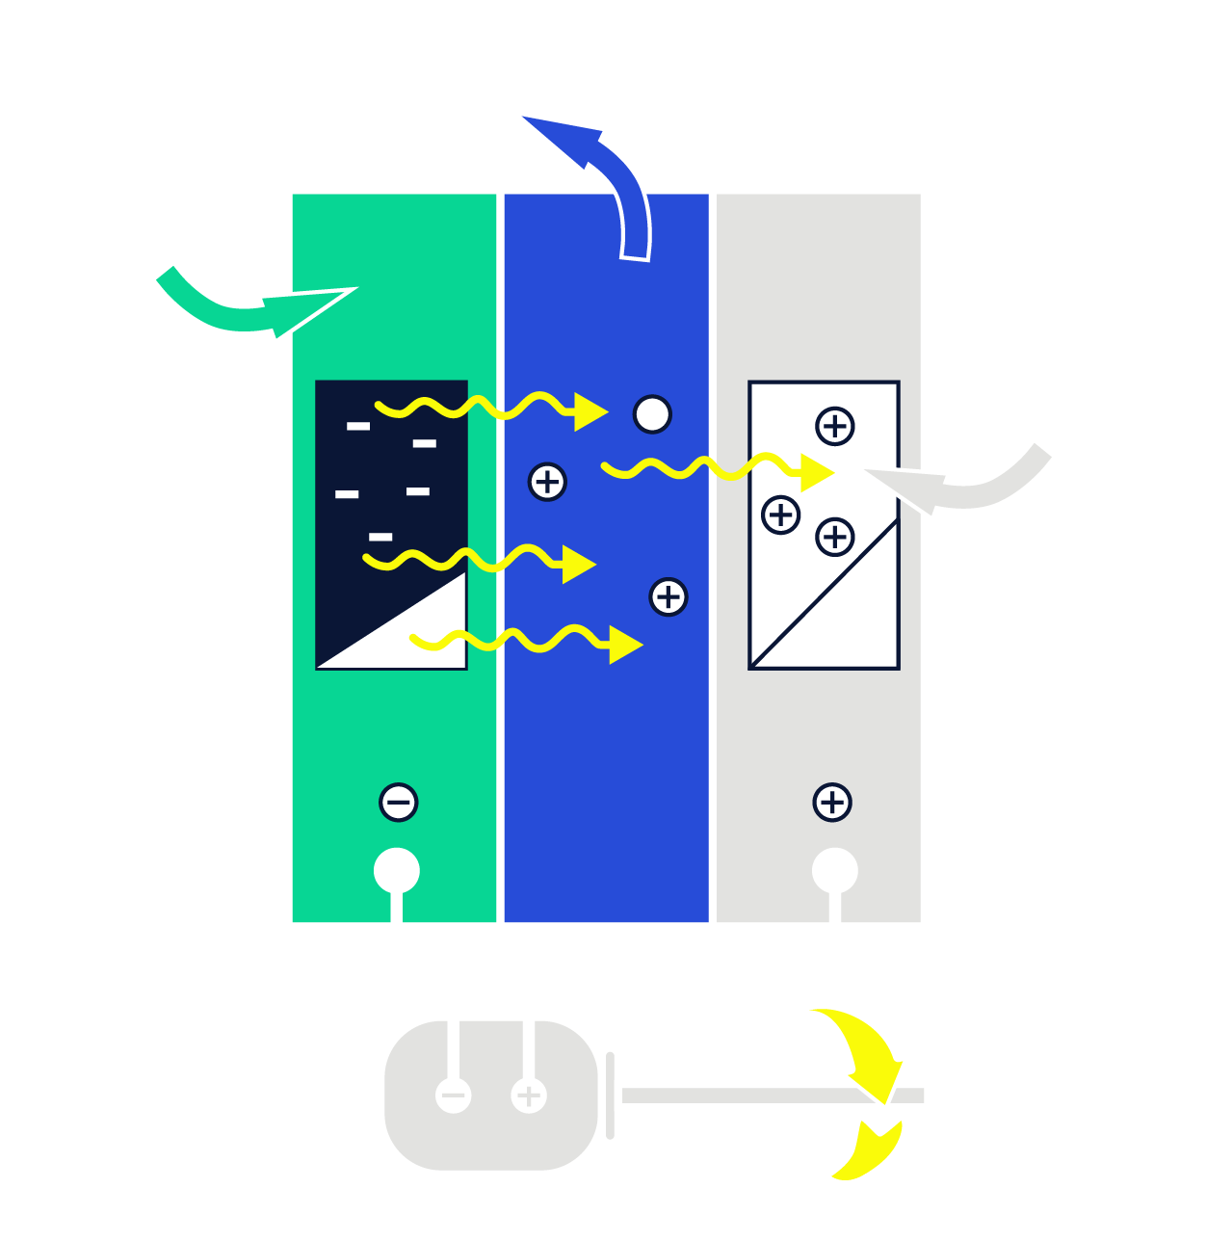
What is a fuel cell?
Hydrogen fuel cell
Fuel cells are an important part of the hydrogen economy. Hydrogen molecules are found in substances such as methane, water and biomass but in all cases some energy is required to extract it.

Slide 14
How to separate hydrogen from water
Hydrogen fuel cell
Hydrogen is the most abundant element in our universe.The problem is it is never alone.
Hydrogen exists as compound with Oxygen or Carbon. To extract Hydrogen, and energy, we must use a process called electrolysis.
This process is often referred to as water splitting, and it can be described by the following chemical reaction:
2H₂O → 2H₂ + O₂

Slide 15
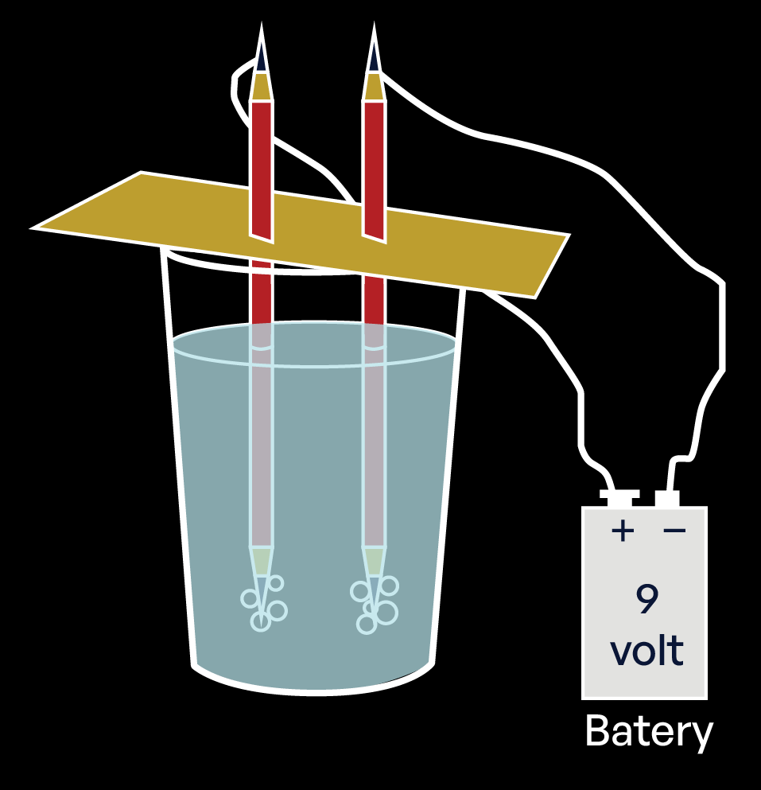
Activity - making hydrogen
Separating Hydrogen from water is easy! Let’s give it a go.
Using your lab sheet, follow the instructions.
If you are successful, you will see tiny Hydrogen bubbles forming in the water at the pencil point.
Notes:
Teacher notes:
Solutions on next slide.

Slide 16

Talking partners - making hydrogen
How could you test if the bubbles were hydrogen?
Were bubbles formed near both pencils? What other gas could be present?
Challenge:
How could this experiment be improved?
Notes:
Teacher notes:
Solutions on next slide.

Slide 17
Plenary
Discuss the following questions:
Why is Hydrogen an important renewable energy resource?
Why is it important for us to be able to make Hydrogen from seawater instead of pure water?
What could you do to promote energy conservation and renewable energy use in your school or community?
What do you need to know next?
Notes:
Teacher notes:
Solutions on next slide.

Slide 18
How successful were you?
How well do you understand the following?
I can describe Hydrogen as an element.
I know why Hydrogen is described as a clean energy.
Stretch and Challenge:
I can explain how a hydrogen fuel cell works.

